Slide 1
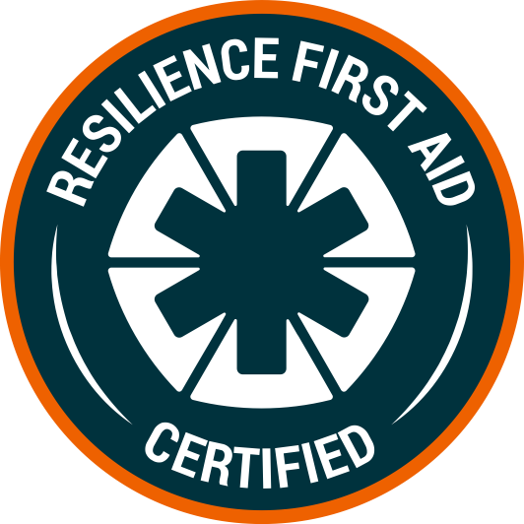
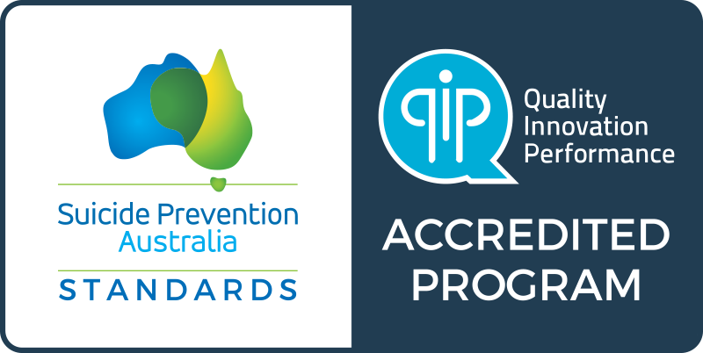
2-Day Resilience First Aid accredited mental health certification. Learn critical skills to proactively support mental health in others.
For Individuals – Learn how to proactively support the mental health of others.
For organisations – Protect the mental health of your staff.
WHY RESILIENCE FIRST AID?
9 out of 10 of people can benefit from increasing resilience skills which protect against mental illness such as depression and anxiety. Throughout the pandemic, this need has only increased.
This is why we need to take a preventative approach to mental health. Rather than waiting until people need professional treatment, we can start supporting each other to connect and build mental wellness proactively.
Resilience First Aid (RFA) as a mental health certification teaches you strength-based skills to build resilience in others. You will learn how to spot signs of low resilience, learn language to talk proactively, and skills that build resilience.
This is a new approach to put trained mental health champions in place who actively boost the resilience and mental health in their communities.
GET CERTIFIED IN RESILIENCE FIRST AID
Join the movement for proactive mental health.
Sign up now
firstaidandfire.com/resiliencefirstaid

Slide 2
ACCREDITED TRAINING
LEARN ABOUT
How to proactively build mental wellness in others
How to support others through six resilience domains
Language to talk proactively about mental health
Respond when someone is struggling
Use a strength-based model to become a source of hope and optimism
How to connect meaningfully to support those around you
IDEAL CANDIDATES
Individuals who wants to be a positive influence in the lives of those around them
Organisations looking to provide the best training to their people to build a culture of proactive care
Occupational Health & Safety departments looking for better ways to reduce risk and promote a healthier workforce
Managers looking to support staff mental health and create a culture of resilience
Colleagues looking to make a positive impact in their teams
COURSE OUTCOME
On completion of the course, you will:
Be Certified for 3 years as a Resilience First Aid Responder
Be able to apply the concepts of preventative mental health
Know how to use the 6 domains of resilience
Be able to spot early on when support is needed
Be able to apply an effective responder protocol
WHAT'S INCLUDED
RFA is a high-impact course that teaches you practical skills alongside the latest neuroscience of preventative mental health. As part of completing the certification, you will receive:
14 hours interactive training on preventative mental health skills
14 hours Continuing Education Credits
12 months access to the Driven Resilience Training programs with full mental health and resilience training courses
Resilience First Aid kit including physical resources to facilitate conversations
Community access to connect with other responders
COURSE FORMAT
Resilience First Aid is a 2-day mental health certification course.
Option 1: Blended – 14 hours blended training
2 hours live video workshop
10 hours self-paced (14 days to complete)
2 hour live video workshop closing session
Option 2: Fully Live – Two days of fully live facilitated training
Course fee: AU$575
Group discounts available
Get in touch – info@firstaidandfire.com
GET CERTIFIED IN RESILIENCE FIRST AID
Join the movement for proactive mental health.
Sign up now
firstaidandfire.com/resiliencefirstaid

